Slide 1

Nashville Soccer Club – Internship MLS Project
A short project based upon position strengthening and player selection inside Major League Soccer.

Slide 2
Background
Assuming the role of a GM of an MLS team, the task was to choose a team, and identify a position that needs strengthening. After the position has been chosen, a maximum of 3 trade targets from inside the league must be selected, along with a guaranteed salary cap of $400,000.
Choose an MLS team
Identify a position to strengthen
Identify up to 3 trade targets

Slide 3
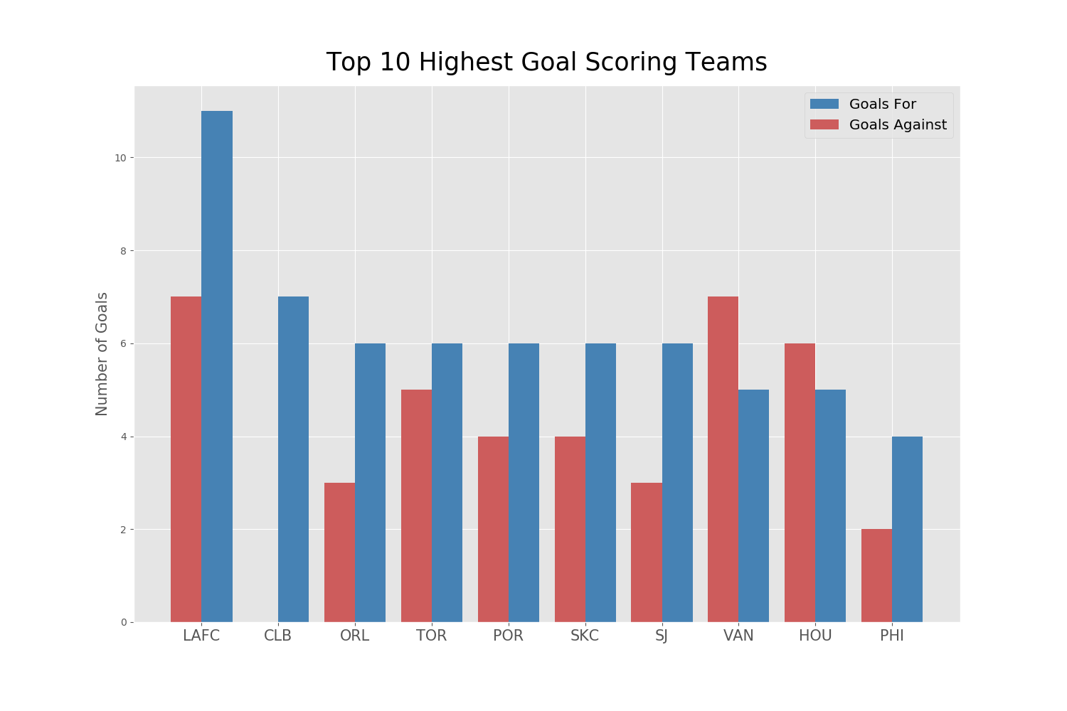
Choice of MLS team
Using web-scraping and MLS.com I was able to grab the standings of all MLS teams during the MLS is Back Tournament.
I found that the team with the most goals for was also one of the teams with the most goals against. Based on this I chose to select LAFC as my MLS team.

Slide 4
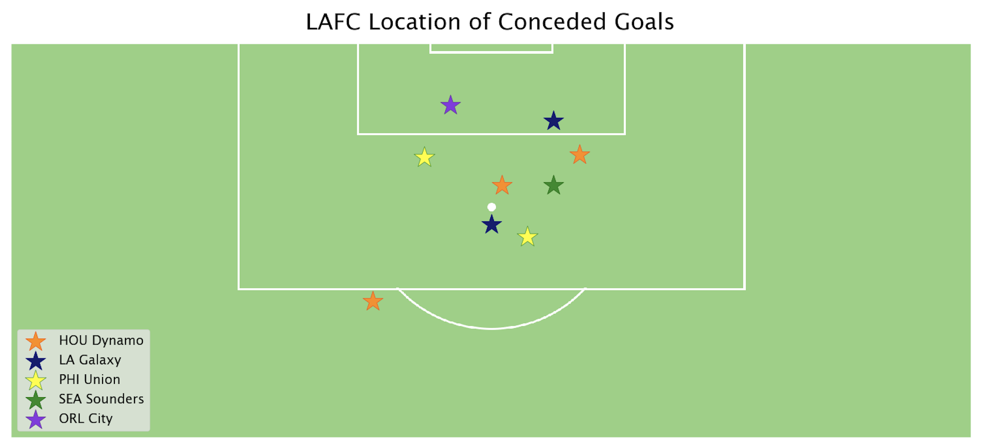
Identifying A position
This process included examining LAFC film of the MLS is Back Tournament, and finding other statistics around the reasons behind conceding so many goals during the tournament. After analyzing film I found the following field position of all goals conceded.

Slide 5
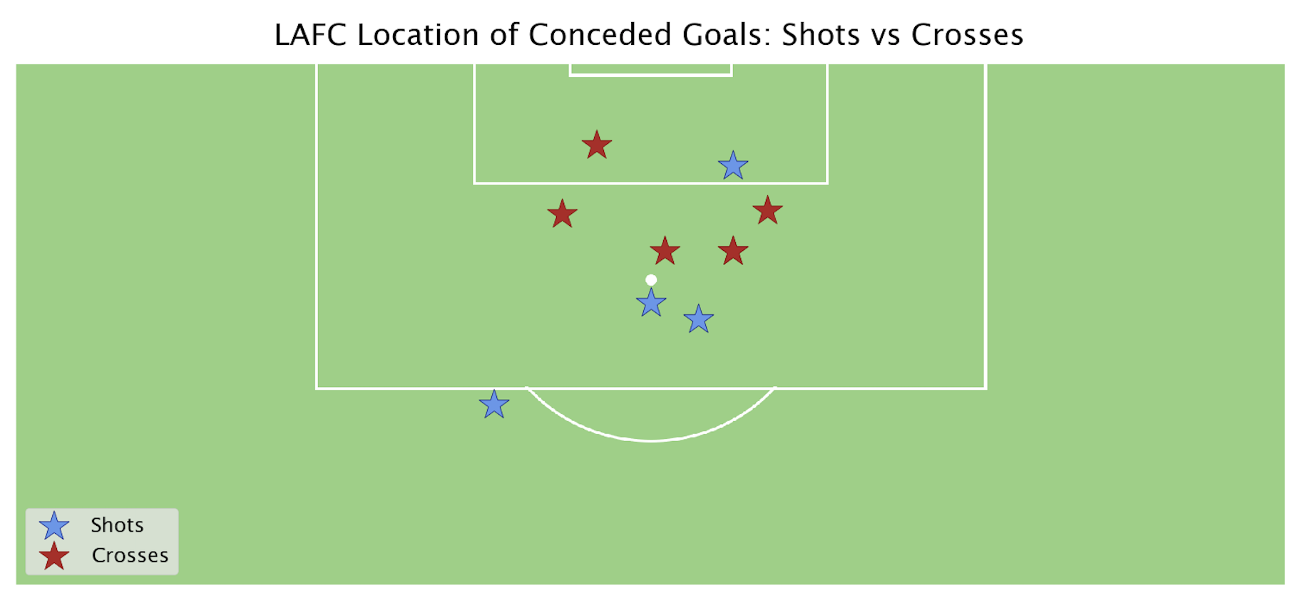
Identifying a position
The most interesting aspect of these conceded goals was that 5 out of 9 goals were aerial goals, this led me to conclude that the position I would be strengthening is the Center Back position.

Slide 6
Trade Target Selection
Based on the few statistics around the goals conceded by LAFC, I produced some target metrics that would allow me to select a center back to strengthen this position, here are those constraints:
Guaranteed Salary Cap of $400,000
Center Back Defender
Large Amount of Professional Experience
Strong Aerially

Slide 7

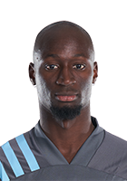
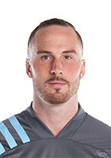
Trade Target Selection
Josh Williams
Height: 6’2”
Weight: 192
Age: 32
Columbus Crew
Ike Opara
Height: 6’2”
Weight: 180
Age: 31
Minnesota United
Brent Kallman
Height: 6’2”
Weight: 190
Age: 29
Minnesota United

Slide 8
Potential Trade Proposals
Due to time constraints and the absolute need to strengthen the LAFC centerback position, we would be willing to trade draft picks along with a potential player swap for Dejan Jakovic.
This is contingent upon negotiation and further analysis.

Slide 9
Other Information
Given more time and more resources, some other directions I would have pursued involve including multiple past season data around each MLS team to make an informed decision around which team to target.
Due to the current Pandemic, performance and the current MLS is Back is not a perfect indication of each club.
Along with gathering past season data, I would have liked to observe the goal conceded position of the past few seasons to build a stronger case around strengthening the Center Back position.
I was unable to gather quality data around the current available players in the Center Back position, I would have liked to gather height, weight, playing time, starts, current teammates, salary, and other metrics to make more data driven decisions around the trade targets.

